Slide 1
UIU Course Selection System

Slide 2
Description
This system typically allows students to browse and search for available courses, view course details such as schedules, prerequisites, and course descriptions, and ultimately select the courses and sections they want to take for a given semester or academic term. The course selection system also have features for managing drop/add requests, and course conflicts.

Slide 3
Our Features
1.Search box
2.Viewing all section
3.prerequisite
4.comment
5.creates advisor/ remove advisor
6.teacher list
7.student list
8.Range (how many teachers will handle how many students)
9.Get notification
10.Accept /decline

Slide 4


Prototype
STUDENT LOGIN ADMIN LOGIN

Slide 5
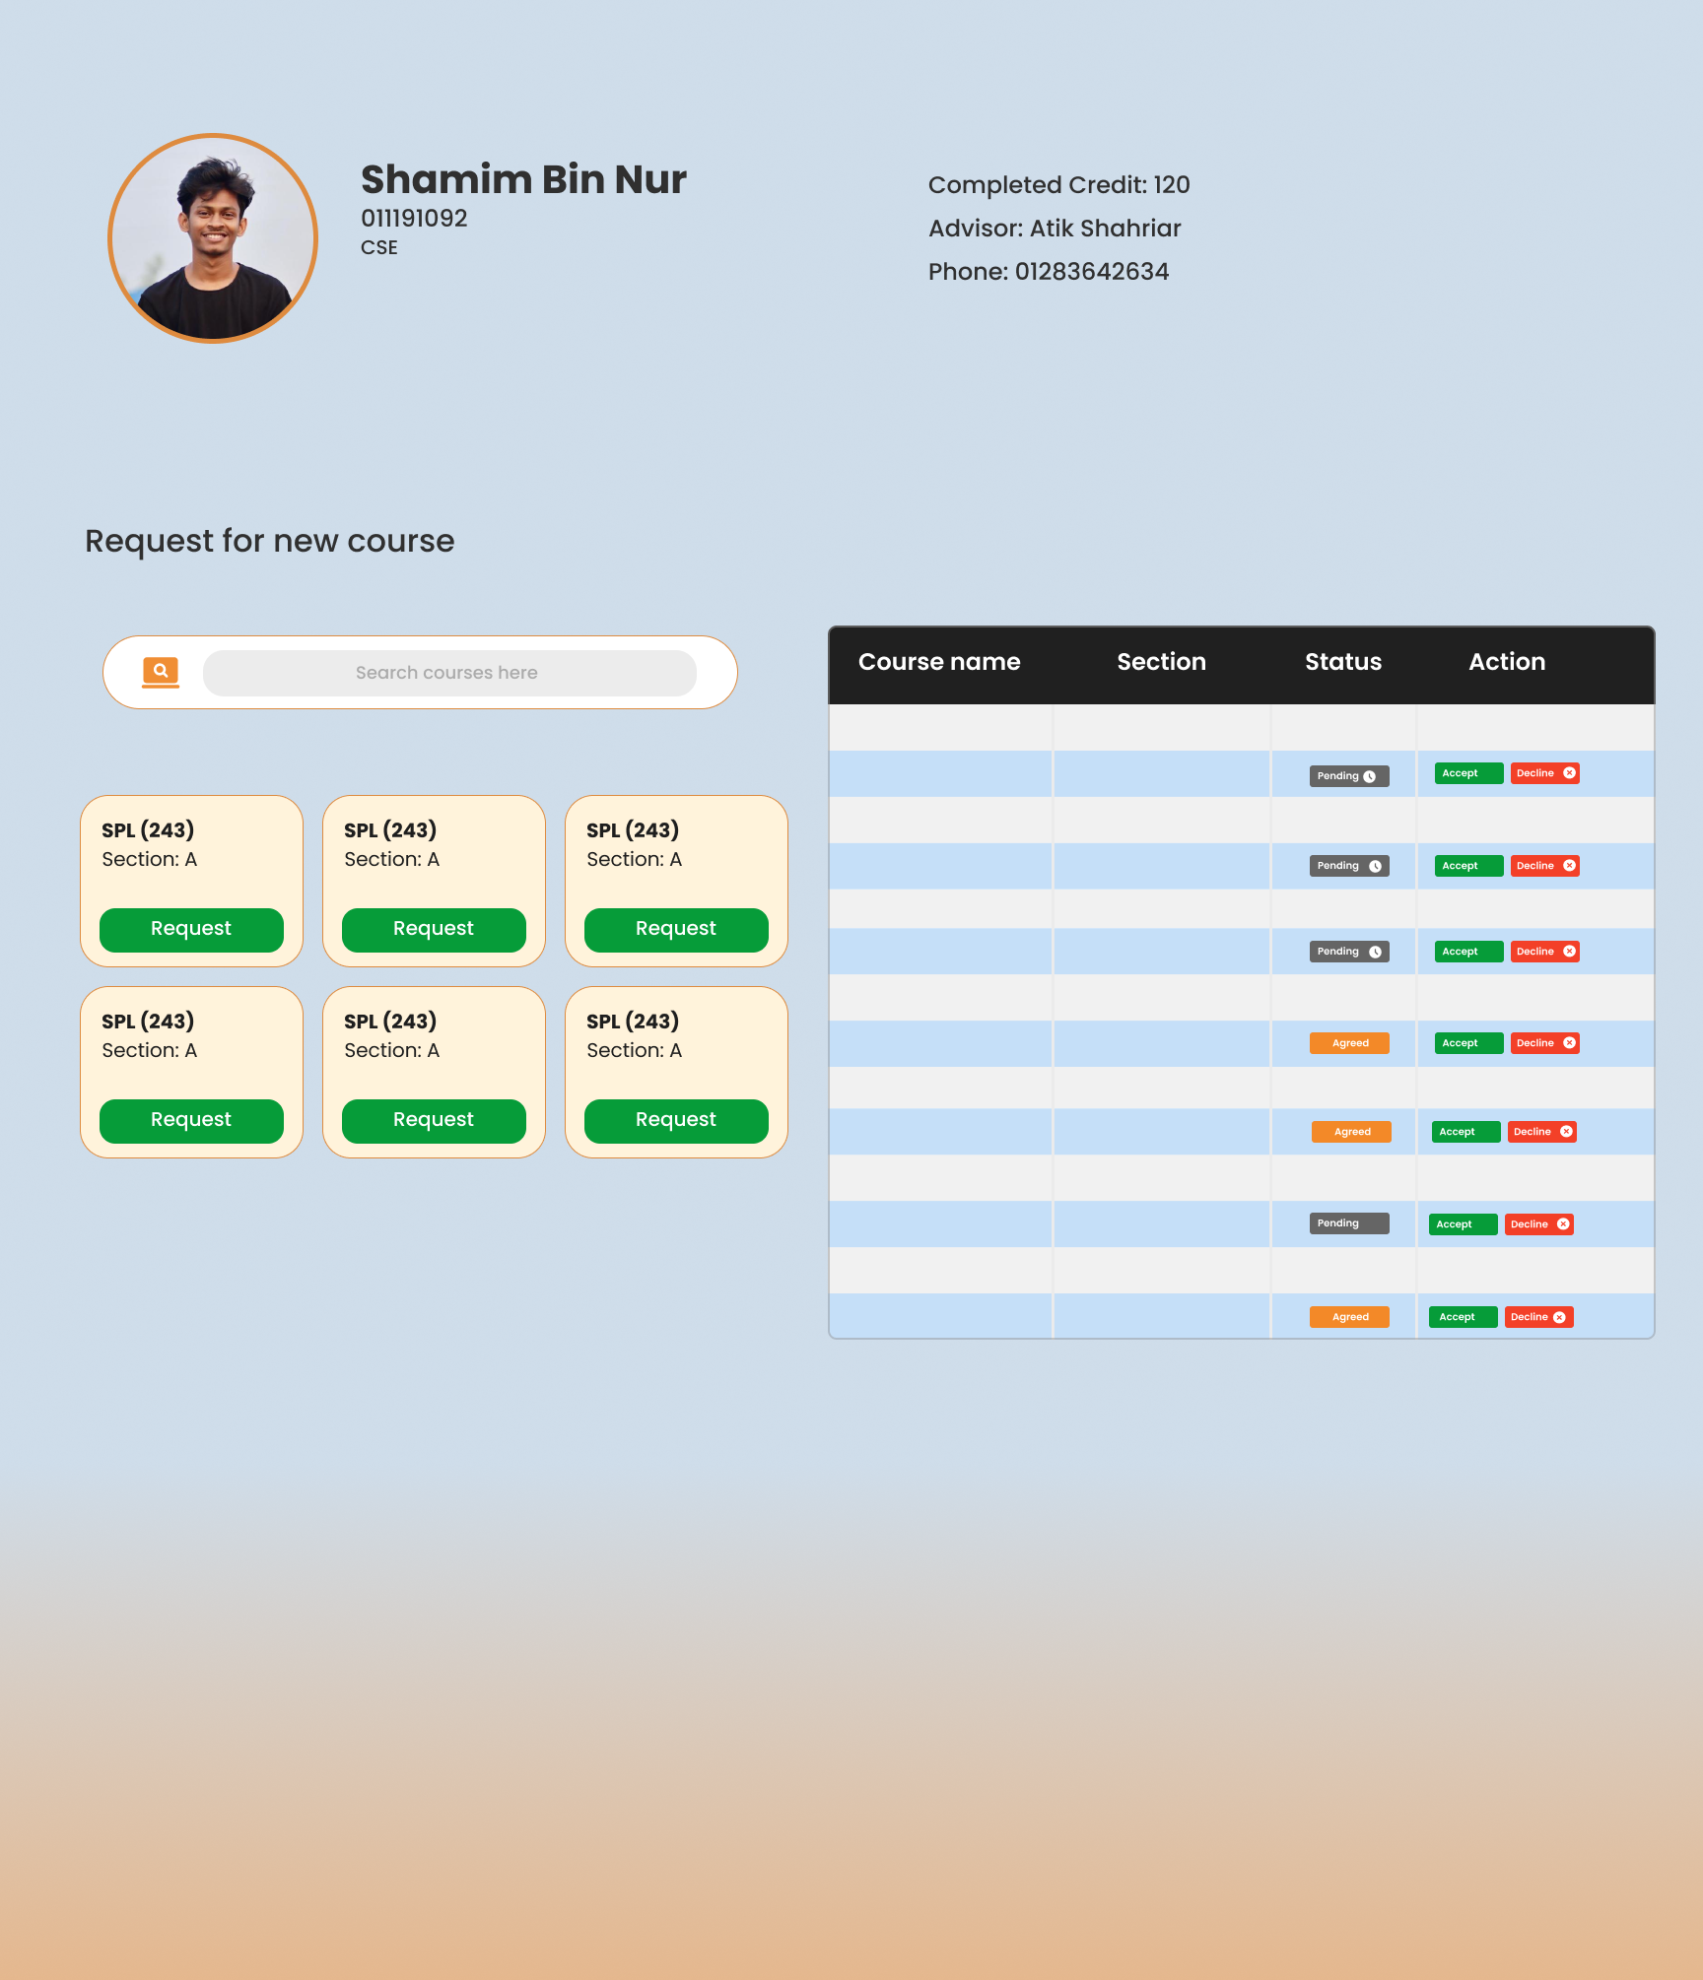
Student view

Slide 6
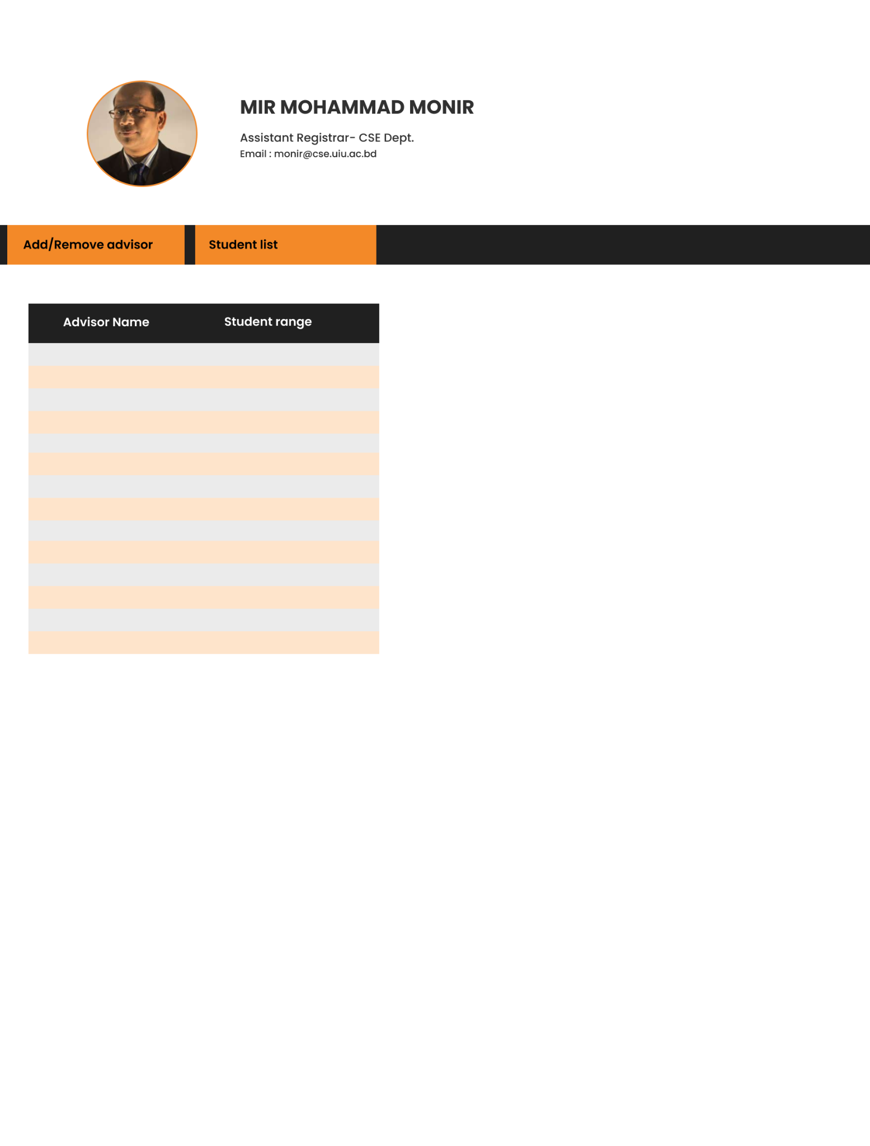
SUPER ADMIN VIEW

Slide 7
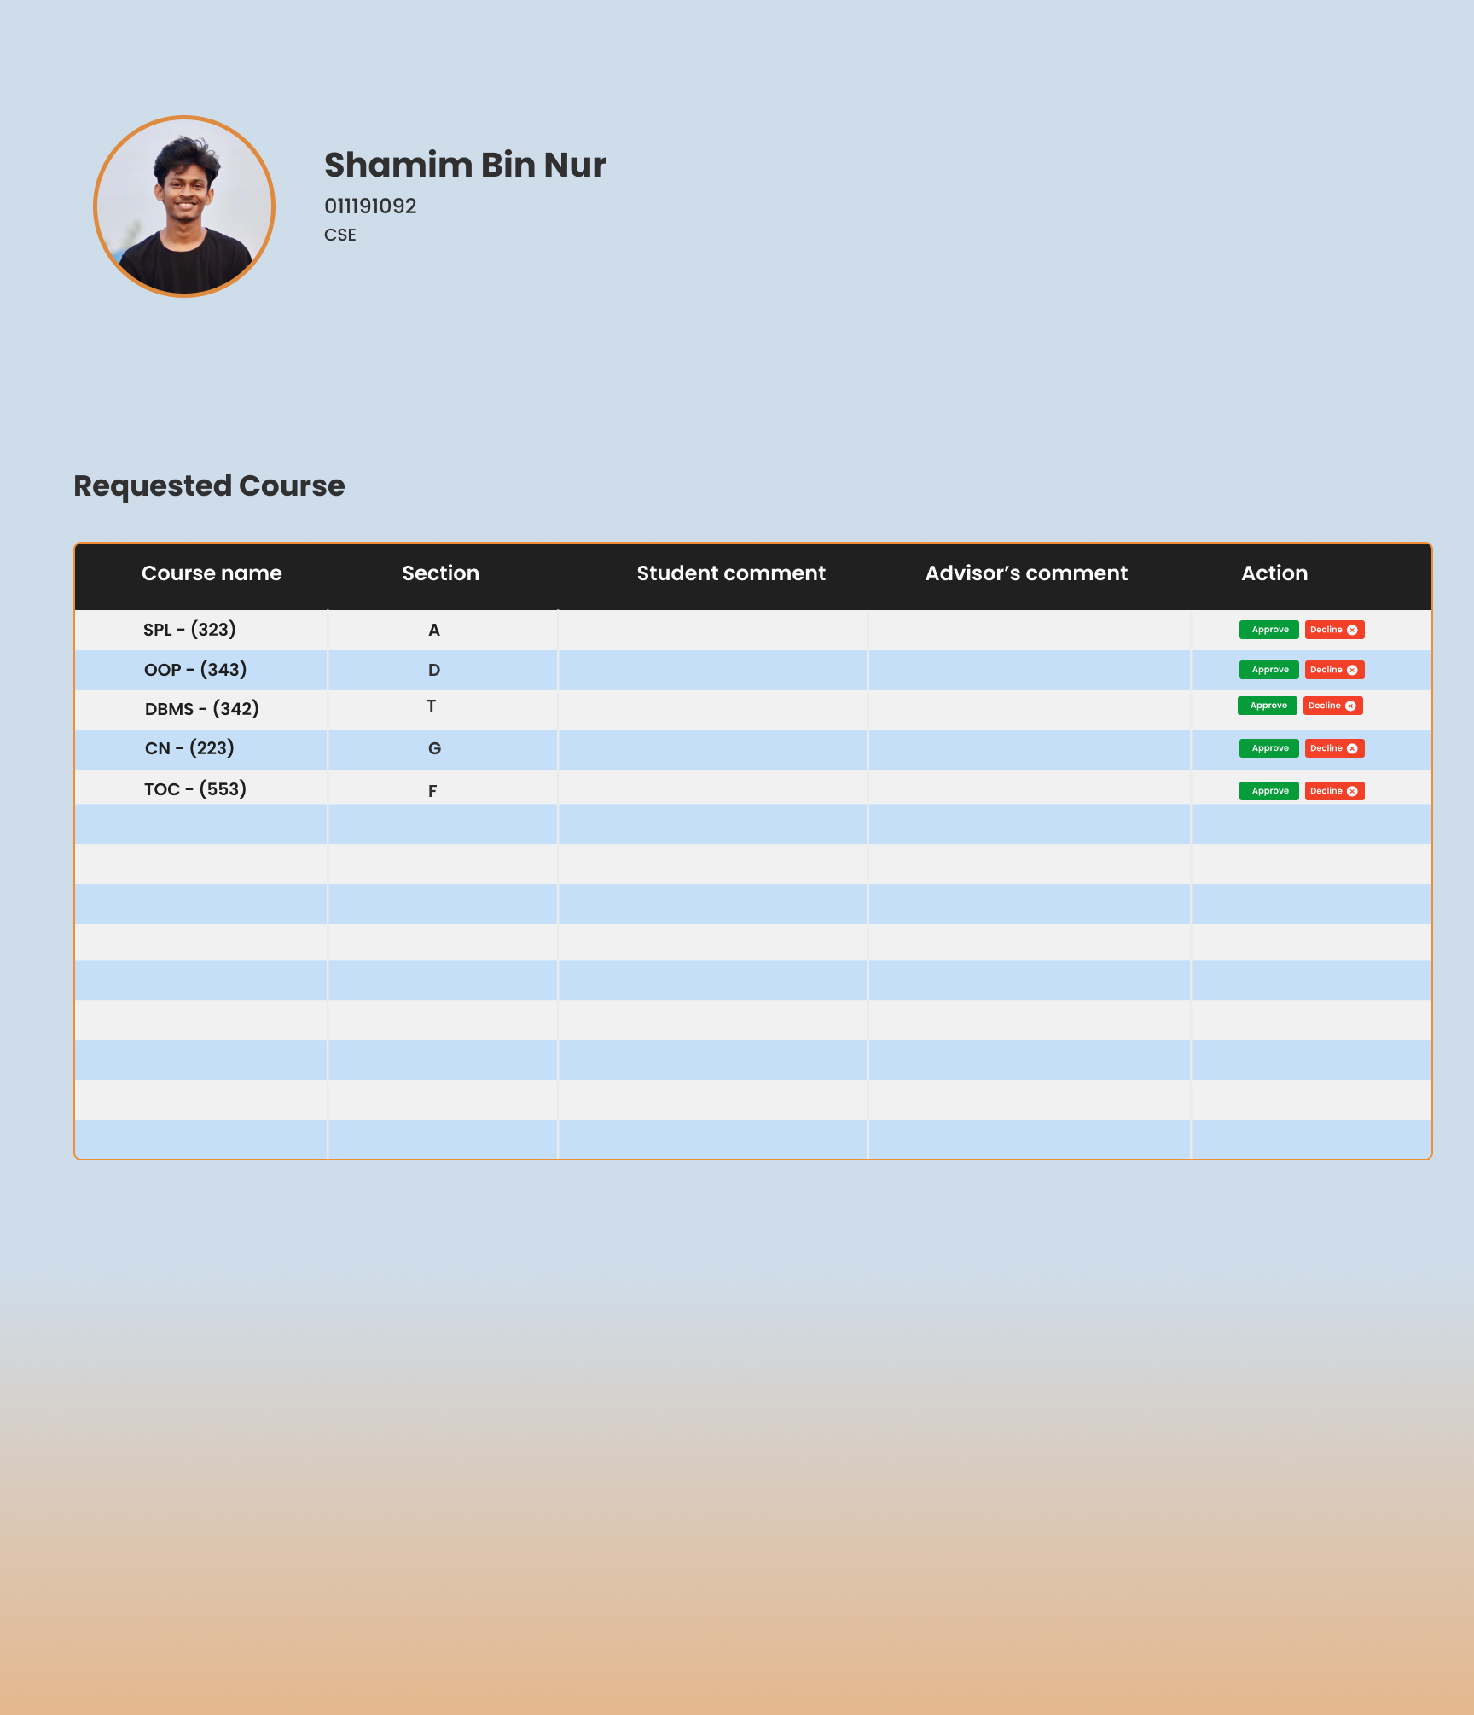
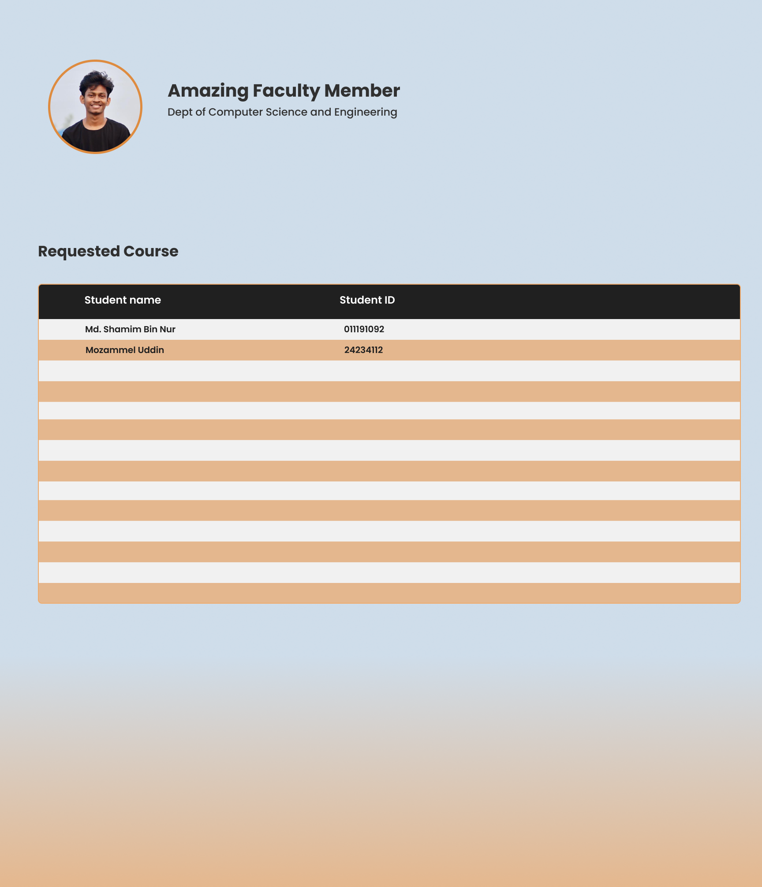
ADMIN VIEW

Slide 8
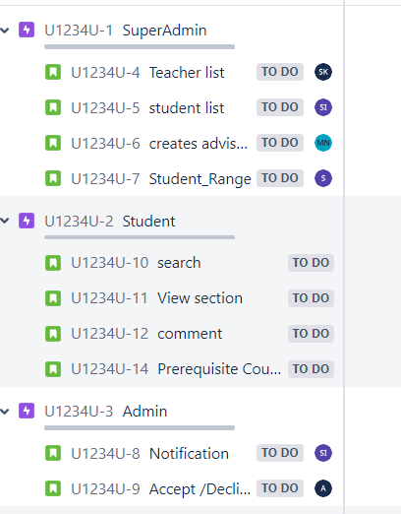
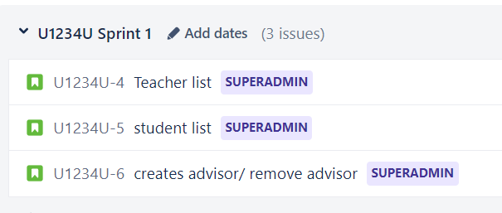
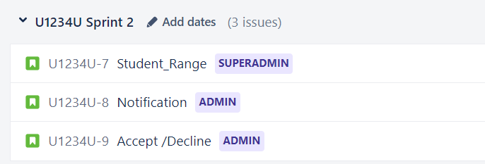
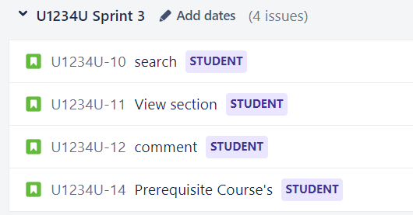
JIRA PLANNING
ROAD MAP
BACKLOG

Slide 9
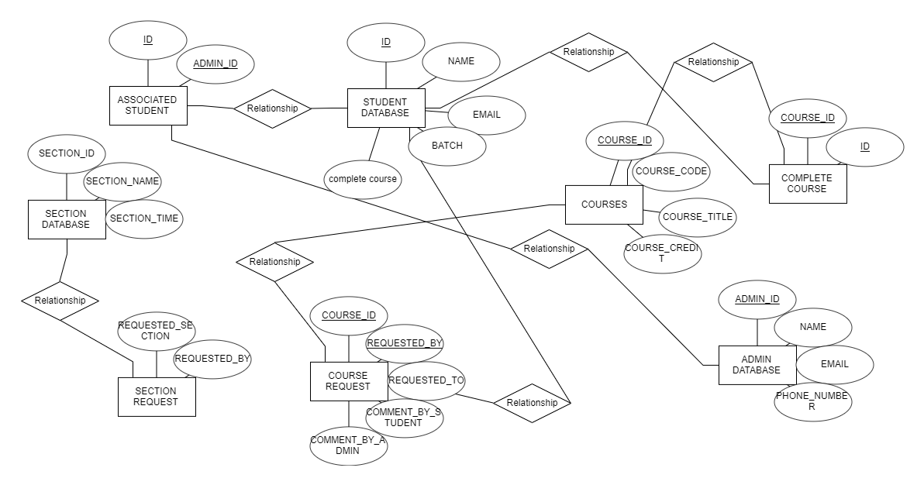
ER DIAGRAM

